Slide 1

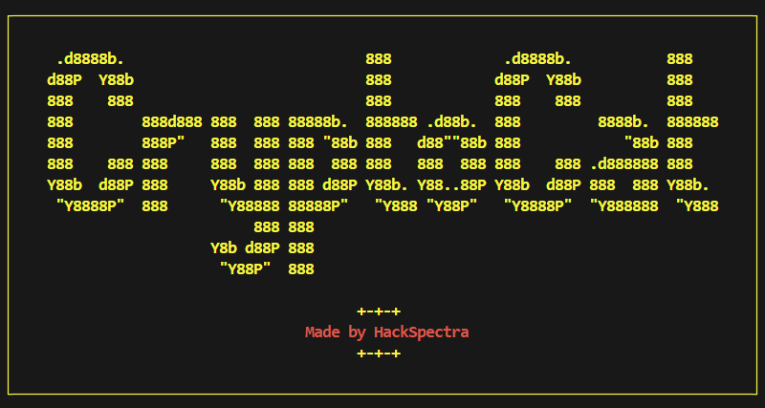

SECURING SYSTEM AGAINST EXTORTION
A Critical Step in Modern Cybersecurity
By – Nandan A M Puneeth Kumar M S
Branch. Computer Science

Slide 2

Abstract
Cybersecurity extortion has emerged as a major threat, exploiting system vulnerabilities to gain unauthorized access to sensitive data or systems, often demanding ransom for their release. This project explores the intersection of cybersecurity extortion and user security awareness through three interconnected tools.
The Password Complexity Checker evaluates password strength based on key parameters like length, use of special characters, and case diversity. By educating users on creating robust passwords, it reduces susceptibility to brute-force and phishing attacks, common tactics used in extortion schemes.

Slide 3
Abstract
The Image Encryption and Decryption Tool secures visual data by encrypting sensitive images with a user-defined key. This protects against ransomware threats, where encrypted files are exploited to extract payment. The tool also highlights the importance of safeguarding private data.
Lastly, the Basic Password Manager offers a secure mechanism for storing passwords, minimizing risks associated with weak or reused credentials. By fostering better password management practices, it addresses vulnerabilities often exploited in extortion-based attacks.
Together, these programs emphasize proactive measures and user empowerment to combat extortion-related cyber threats. They demonstrate the critical role of data encryption, secure authentication, and user education in mitigating cybersecurity risks.

Slide 4

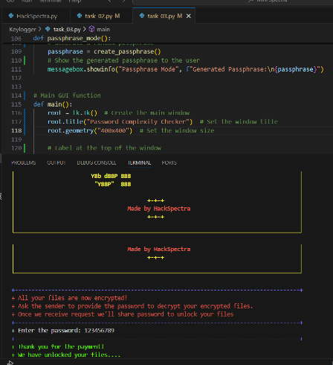
Introduction
A Critical Step in Modern Cybersecurity

Slide 5
Introduction
Recent developments in the field of image encryption are driving advancements in information security, particularly with the use of specialized algorithms designed for multimedia data. Traditional encryption methods like AES and RSA face challenges due to their slow processing speeds and high computational demands, which are not ideal for real-time image encryption. As a result, newer approaches like chaotic systems, neural networks, and DNA encoding are being explored for their effectiveness in securing image data.
Additionally, there has been significant progress in password complexity and security, highlighted by the use of advanced encryption techniques such as event-driven optical encryption. This method integrates neuromorphic imaging principles, paving the way for enhanced data security in various applications, including image encryption.

Slide 6
File Encryption:
File Encryption ensures data confidentiality by encrypting files with a secure key. It prevents unauthorized access, allowing users to safely encrypt or decrypt sensitive documents. With its simple interface, users can easily secure their files while safeguarding against data breaches. This tool is a vital step in modern cybersecurity practices..

Slide 7
Libraries and Frameworks used
1. Tkinter: A built-in Python library for creating graphical user interfaces (GUI).
2. re: A Python module for working with regular expressions.
3. secrets: A module used to generate secure random numbers and strings, suitable for cryptography.
4. string: A module providing constants for string operations, such as punctuation characters and letters.

Slide 8
Applications of File Encryption
Data Protection: Secures sensitive personal or corporate documents, ensuring confidentiality during storage or transmission.Secure
File Sharing: Enables safe sharing of encrypted files over email or cloud storage, preventing unauthorized access.
Compliance: Assists organizations in meeting regulatory requirements like GDPR, HIPAA, and PCI-DSS for secure data handling.
Ransomware Defense: Mitigates the risk of data exposure in ransomware attacks by keeping files encrypted.

Slide 9
Image Encryption
Image encryption involves converting an image into an unreadable format to protect it from unauthorized access. This is achieved by scrambling the image’s pixel values using encryption algorithms. The process ensures the confidentiality of sensitive visual data during storage or transmission. Common techniques include symmetric encryption, where the same key is used for both encryption and decryption, and asymmetric encryption, which uses a public and private key pair. Image encryption is vital for securing personal photographs, confidential documents, and other visual content. It plays an essential role in secure communications, cloud storage, and digital forensics.

Slide 10
Advantages of Laser Transmission device :
Data Privacy: Image encryption ensures that sensitive visual data remains confidential, preventing unauthorized access.
Security during Transmission: Encrypted images are protected while being transmitted over the internet, reducing the risk of interception.
Protection against Unauthorized Access: It prevents unauthorized users from viewing or tampering with images stored on devices or cloud storage.

Slide 11
Libraries and Frameworks are used
:
Tkinter: The standard Python library for creating graphical user interfaces (GUIs). It's used for creating the main window, buttons, labels, and input dialogs for user interaction.
os: The built-in Python module for interacting with the operating system, used here for file operations, such as opening the image after decryption.
filedialog (from Tkinter): Used for opening the file dialog, allowing the user to select the image file they want to encrypt or decrypt

Slide 12
Libraries and Frameworks are used
simpledialog (from Tkinter): Used to prompt the user to enter a numeric key for encryption or decryption.messagebox (from Tkinter): Provides pop-up message boxes to display information, warnings, or errors to the user.

Slide 13
Password Checker
The Password Checker is a tool designed to evaluate the strength of user-entered passwords based on predefined security criteria. It checks whether the password meets various requirements such as a minimum length, inclusion of uppercase and lowercase letters, digits, and special characters. Based on the password's compliance with these rules, the tool provides a strength rating (e.g., Weak, Moderate, Strong, Very Strong) and offers feedback to help users improve their passwords. Additionally, the program can suggest strong passwords or generate passphrases, providing a comprehensive solution for improving password security. It uses encryption methods to securely assess and suggest passwords, ensuring user data is protected.

Slide 14
Password Checker
The Password Checker is a tool designed to evaluate the strength of user-entered passwords based on predefined security criteria. It checks whether the password meets various requirements such as a minimum length, inclusion of uppercase and lowercase letters, digits, and special characters. Based on the password's compliance with these rules, the tool provides a strength rating (e.g., Weak, Moderate, Strong, Very Strong) and offers feedback to help users improve their passwords. Additionally, the program can suggest strong passwords or generate passphrases, providing a comprehensive solution for improving password security. It uses encryption methods to securely assess and suggest passwords, ensuring user data is protected.

Slide 15
Libraries and Frameworks are used
Tkinter: Used for creating the graphical user interface (GUI) components.
secrets: Used for generating secure random passwords and passphrases.
string: Provides predefined character sets (letters, digits, punctuation) for password generation.
re: Potentially used for regular expressions (though not explicitly used in the given code).

Slide 16

The tools provided for image encryption/decryption, password checking, and password complexity evaluation are intended for educational and demonstration purposes only. While they offer basic functionality to help users assess password strength and generate random passwords or passphrases, they do not guarantee robust security. The encryption method used in the image tool is simple and may not be secure for sensitive data. Users are responsible for ensuring compliance with legal and security standards, and it is recommended to implement additional security measures such as multi-factor authentication (MFA) for enhanced protection. The developers do not accept any liability for any loss, damage, or security issues arising from the use of these tools.
© 2024 - 2025 - All Rights Reserved

